Slide 1

Wine Quality Prediction
Springboard Data Science Career Track
Samia Saad
April 2025

Slide 2

Problem Statement
• Can we predict wine quality using chemical properties?
• Helps winemakers improve quality control & decision-making.
• Supports data-driven production and marketing strategies.

Slide 3
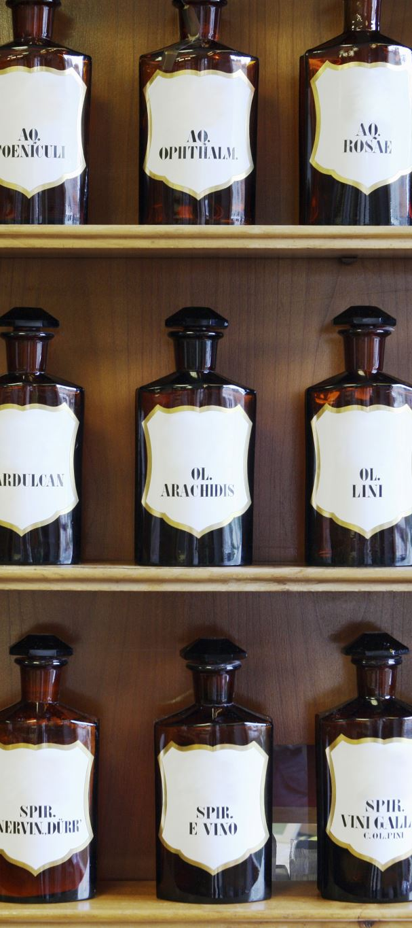
The Dataset
• Source: UCI Wine Quality Dataset
• Two datasets: Red and White wine
• Target: Wine quality score (0–10 scale)
• ~6,500 records with 11 features each

Slide 4

Exploratory Data Analysis (EDA)
• Alcohol and sulphates positively correlated with quality
• Volatile acidity negatively correlated
• Class imbalance: most wines are rated 5-6

Slide 5
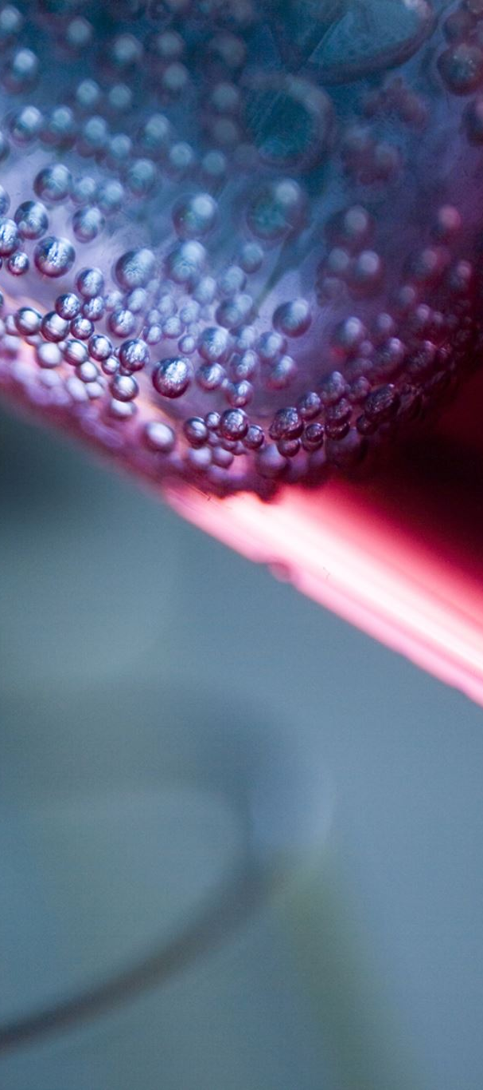
Data Preparation
• Combined red and white wine datasets
• Added 'wine_type' feature (one-hot encoded)
• Standardized numerical features
• Train-test split (80/20)

Slide 6
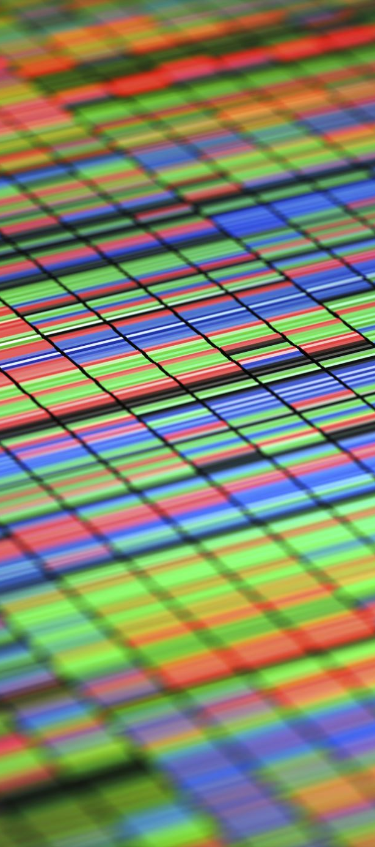
Modeling Approach
• Algorithm: Random Forest Classifier
• Handles feature importance and non-linear patterns
• Hyperparameter tuning: 100 estimators, max depth 10

Slide 7

Model Evaluation
• Accuracy: 83%
• Precision: 81%
• Recall: 80%
• F1 Score: 0.805

Slide 8
Feature Importance
• Top features influencing quality:
- Alcohol
- Sulphates
- Volatile Acidity
• Alcohol is the most predictive feature

Slide 9
Key Recommendations
1. Use separate models for red and white wine.
2. Focus on alcohol and sulphate levels for quality.
3. Use model predictions to guide pricing strategy.

Slide 10

Limitations & Future Work
• Subjectivity in quality scores
• Explore regression for precise quality scoring
• Add external features: grape type, region, etc.
• Test deep learning models for performance

Slide 11
Thank You / Q&A
Thank you for your time!
Happy to answer any questions.

